Slide 1



ADVANCED ARTIFICIAL INTELLIGENCE
nstructor: Dr. Alaa Mahmoud Hamdy

Slide 2

02
WHAT IS INTELLIGENT VIDEO ANALYSIS?
This project integrates theoretical concepts with practical implementation, focusing on data preprocessing, model development, and evaluation. It aims to develop a robust detection system for advanced safety and monitoring applications.

Slide 3
03
1
Introduction and Overview
AGENDA
2
Dataset
3
Data Preprocessing
4
Implementation
5
Alternative

Slide 4
04
INTRODUCTION AND OVERVIEW
The project aims to create a real-time system for detecting violence in videos, enhancing response capabilities for law enforcement and media monitoring. It uses deep learning models and advanced AI techniques to recognize complex patterns and human actions, helping prevent critical incidents from escalating.

Slide 5
05
DATASET
2 Main classes
1. Normal
2. Violence
Violence has 2 sub-classes
1. Violence
2. Weaponized

Slide 6
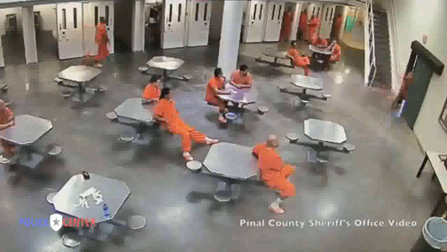
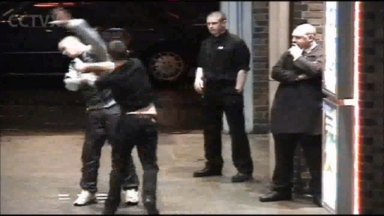
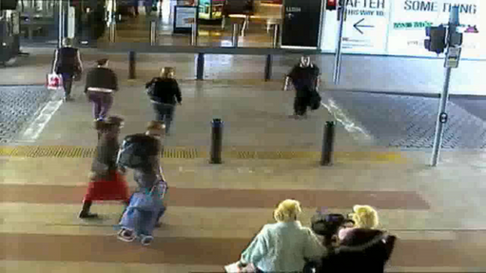
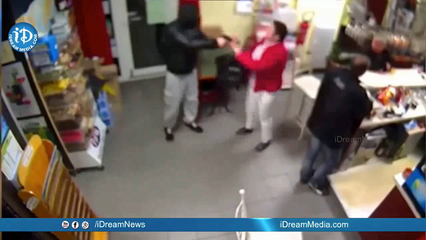
06
CLOSER LOOK ON DATASET
Categories: Normal and Violence.
Data split: Training (80%) and Validation (20%).
Transformations applied:
Resize images to 224x224.
Converted to PyTorch tensors.
Normal Class
Violence Class

Slide 7
07
DATA PREPROCESSING
Extracted frames from videos for training and testing.
Preprocessing Steps:
Resizing for model input.
Frame normalization for consistency.
Tools used: OpenCV, TensorFlow, matplotlib.

Slide 8
08
VIOLENCE DETECTION MODEL: CNN-LSTM APPROACH
Used MobileNetV2 for frame-level feature extraction
LSTM layers to capture temporal patterns in videos
Key Features:
Efficient MobileNetV2 backbone ensures fast, lightweight processing
LSTM to capture motion and temporal dynamics
Processes 15 sampled frames per video clip
Designed to classify between Normal and Violent behaviors

Slide 9
09
MODEL ARCHITECTURE
MobileNetV2 efficiently extracts detailed spatial features from each video frame.
LSTM processes sequential frame data to:
Capture motion and temporal dependencies over time.
Learn patterns of behavior across consecutive frames.
Model built and trained from scratch to accurately classify violent and non-violent actions.

Slide 10
10
TRAINING & VALIDATION
Training process:
Loss function: Binary Crossentropy.
Optimizer: Adam with a learning rate of 0.001.
Results:
Validation accuracy and loss visualized over epochs.
Confusion matrix to assess predictions.
Model Evaluation:
Accuracy(+98%), precision, and recall metrics.

Slide 11
THANK YOU FOR
YOUR PRECIOUS TIME
Presented by:
Malak Mohamed 2022/07005

